Slide 1

Gen Z Career Aspirations

Slide 2
Project Process
Why This Project.
Problem Statement.
Data Collection.
Excel Dashboard.
(Data Cleaning) Analysis using SQL.
Power BI Dashboard.
Insights.

Slide 3
Why This Project
Introduction:
"Generation Z, or known as Gen Z, are born between 1997 and 2012, is rapidly becoming the dominant force in the workforce, especially within the technology sector. Their unique perspectives, digital fluency, and evolving expectations are reshaping the landscape of IT jobs. This project aims to analyse the impact of Gen Z on the IT industry and to understand their motivations, preferences, and contributions."

Slide 4
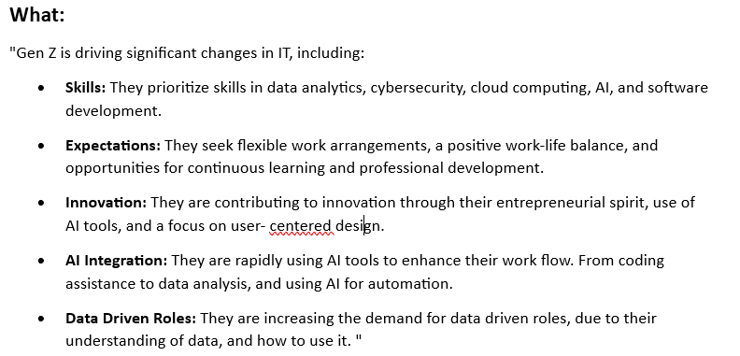
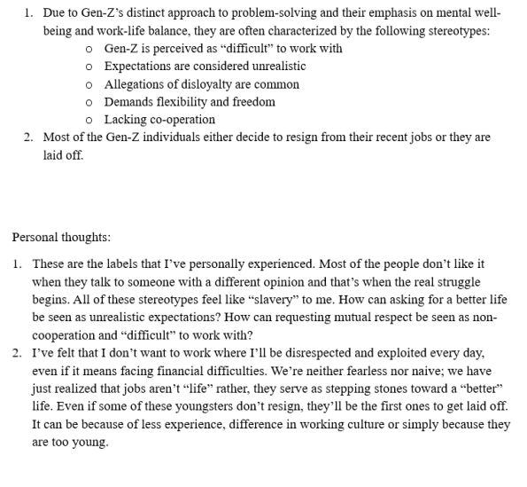
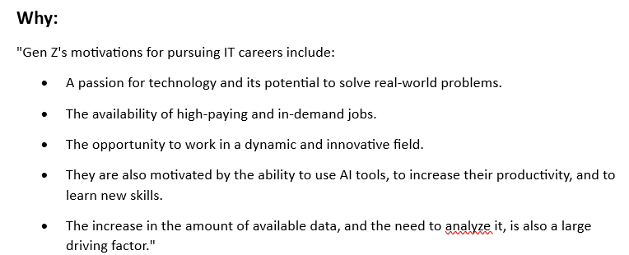
Problem Statement
What is Happening

Slide 5
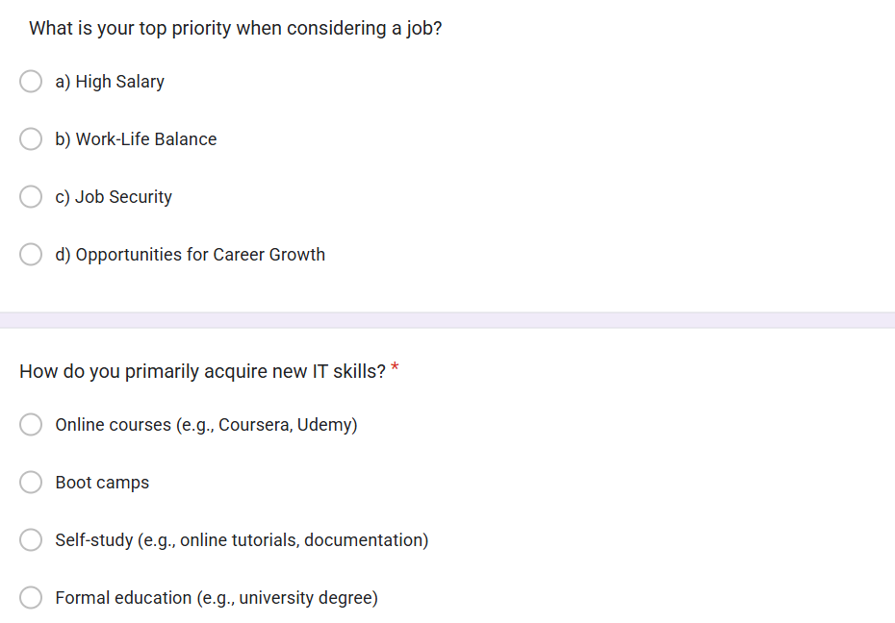
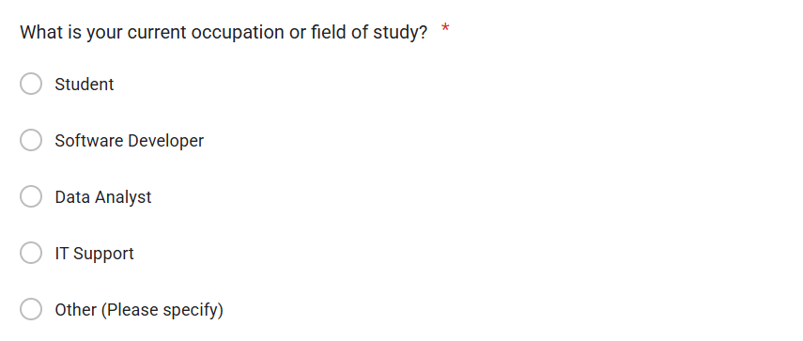
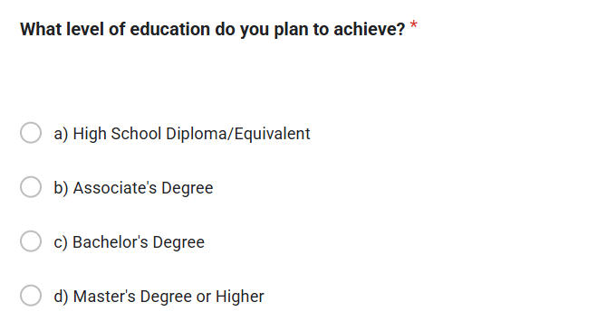
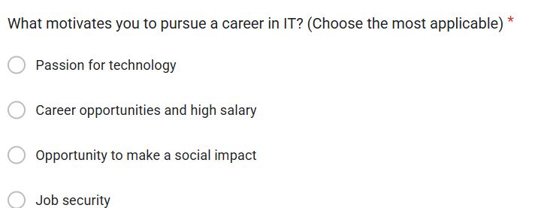
Data Collection
Data Collected through survey.

Slide 6
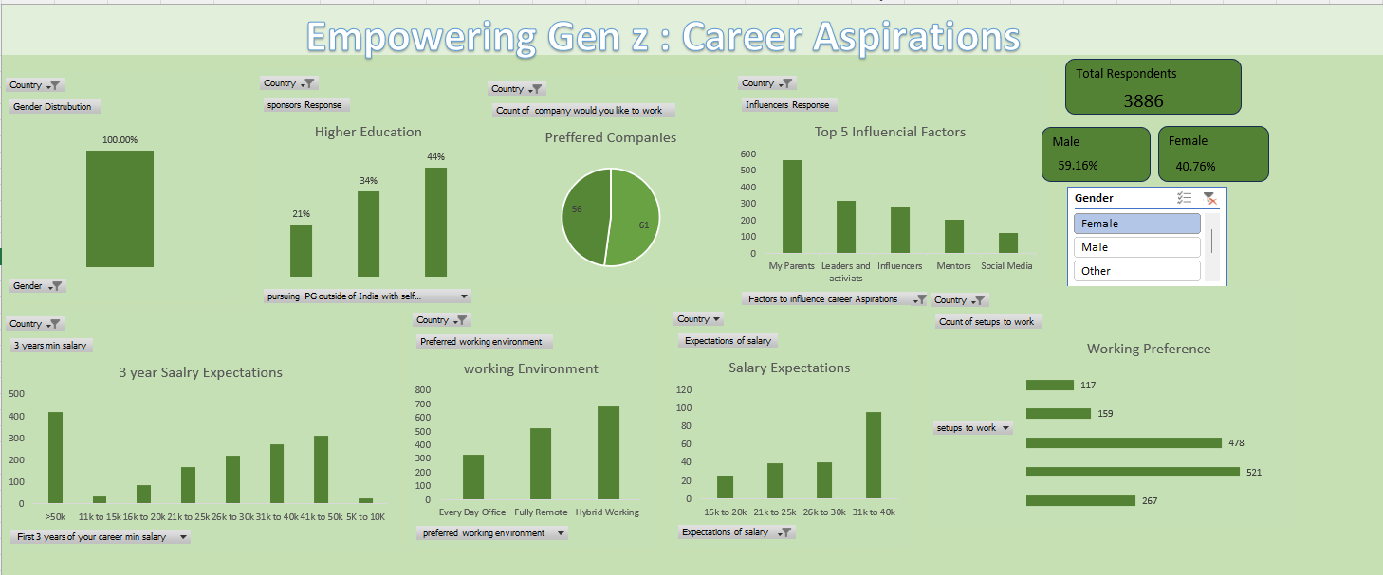
Excel Dashboard

Slide 7
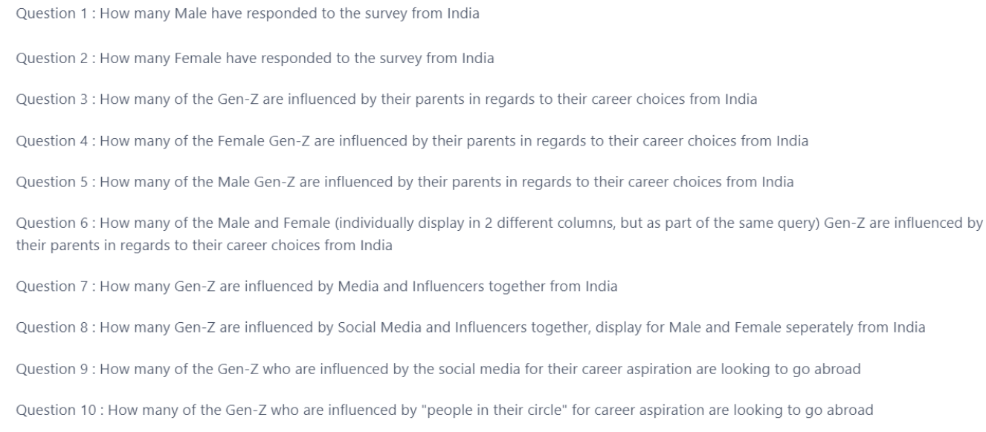
Analysis Using SQL

Slide 8
Power BI Dashboards
MISSION
ASPIRATIONS :
Exploring Gen Z Work Trends:
Analysing salary exceptions, Mission preferences and the impact of company missions on employee satisfaction and the impact on laid off employees
MANAGER ASPIRATIONS:
Exploring Gen Z Managerial Dynamics:
Unveiling preferences in tenure, managerial styles, employer qualities, and team sizes for a understanding of the evolving professional landscape due to Gen Z
LEARNING ASPIRATIONS :
Gen Z Education & Career Insights:
Explore Gen Z’s educational preferences, top career choices, Influential Factors shaping their career decisions and insights into their preferred work styles.

Slide 9
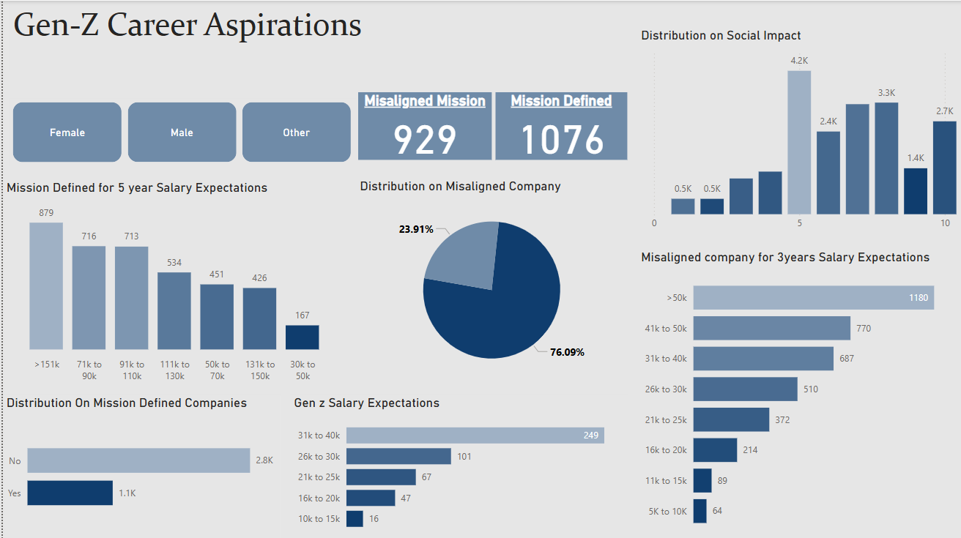
Mission Aspirations

Slide 10
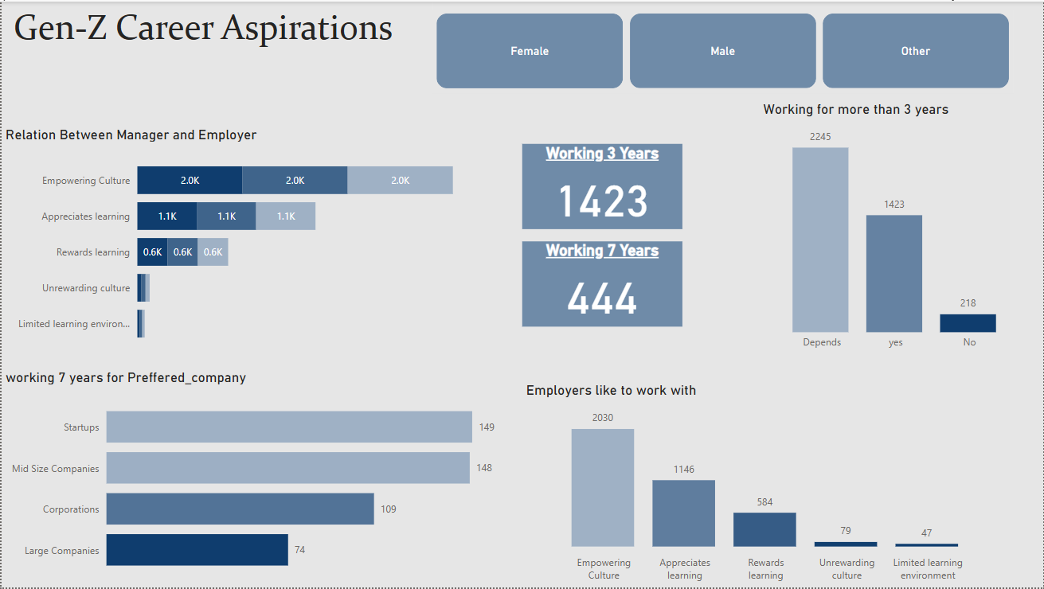
Manager Aspirations

Slide 11
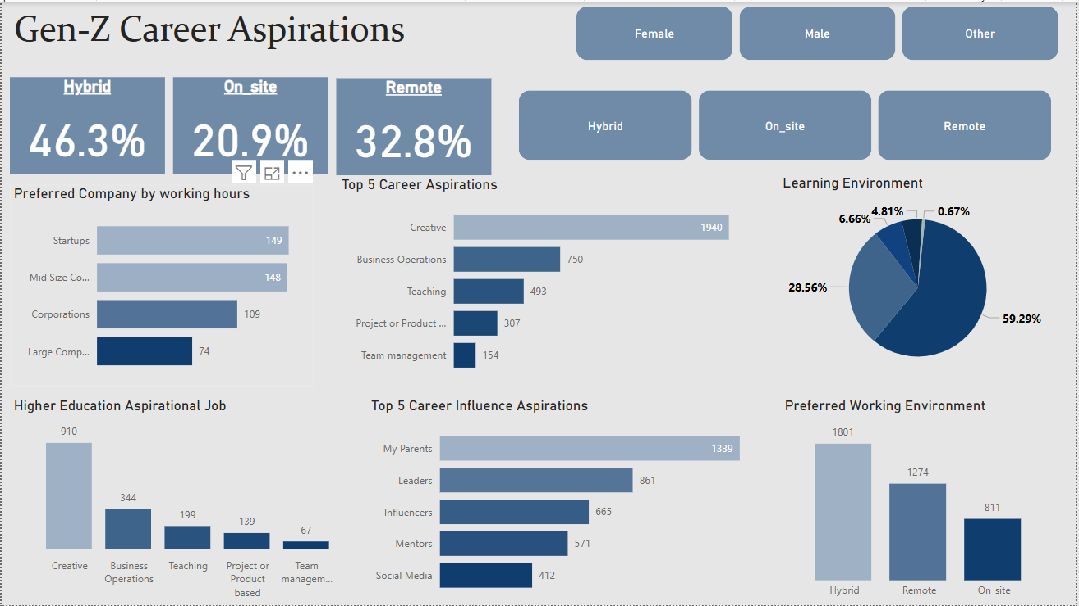
Learning Aspirations

Slide 12
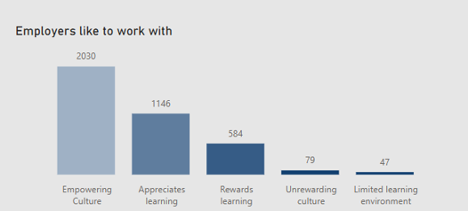
Problem
Stagnant Growth
Insights
Gen Z wants to work for manager who offers
RECOMMENDATIONS :
Create personalized career development plans.
Encourage cross-functional projects.
Recognize employees achievements

Slide 13
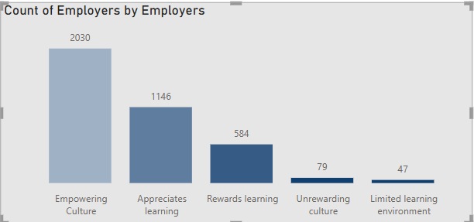
Problem
Poor Managers or Leaderships
Insights
Gen Z wants to work for manager who offers
RECOMMENDATIONS :
Invest in leaderships development programs.
Implement a feedback system.

Slide 14
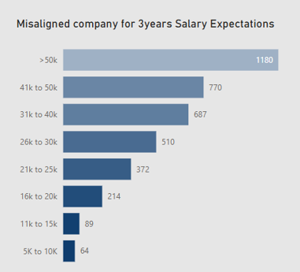
Problem
Poor or Low salaries
Insights
Salary Expectations for 3 years Experience
RECOMMENDATIONS :
Conduct regular market research.
Communicate openly about the company’s financial situation.
Implement performance-based pay.

Slide 15
Thank you..

